Slide 1
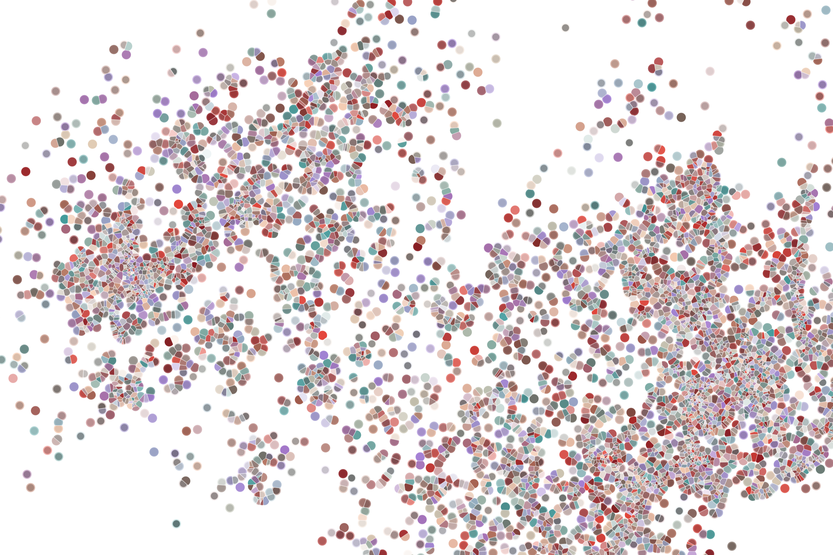
Package architecture
Physalia course 2022
Instructor: Jacques Serizay
Notes:
Hello everybody and thank you for attending my presentation. I am going to talk about the project I recently started working on in the Spassky and Koszul labs, both located in Paris. This project focuses on the unusual cooption of the mitotic machinery to drive, not cell division but cell differentiation.

Slide 2
What are packages
R “core” is already a mix of several packages !
base
compiler
datasets
graphics
grDevices
grid
methods
parallel
splines
stats
stats4
tcltk
tools
translations
utils

Slide 3
What are packages
R “core” is already a mix of several packages !
base
compiler
datasets
graphics
grDevices
grid
methods
parallel
splines
stats
stats4
tcltk
tools
translations
utils
R preferred extension mechanism: new functionalities (through new functions, but not only!)

Slide 4
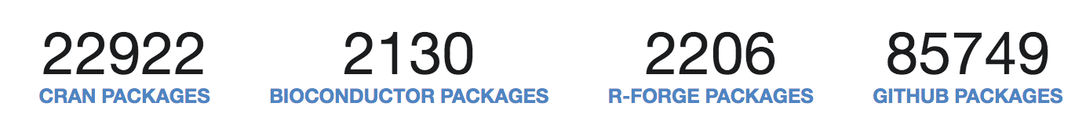
What are packages
R “core” is already a mix of several packages !
base
compiler
datasets
graphics
grDevices
grid
methods
parallel
splines
stats
stats4
tcltk
tools
translations
utils
R preferred extension mechanism: new functionalities (through new functions, but not only!)
https://rdrr.io/

Slide 5
Standard package source: the bare minimum
myPackage/
R/
functions.R
utils.R
DESCRIPTION
NAMESPACE

Slide 6
Standard package source: more complete structure
myPackage/
data/
man/
inst/
tests/
vignettes/
R/
functions.R
utils.R
DESCRIPTION
NAMESPACE
README.md
NEWS
LICENSE

Slide 7
DESCRIPTION
myPackage/
data/
man/
inst/
tests/
vignettes/
R/
functions.R
utils.R
DESCRIPTION
NAMESPACE
README.md
NEWS
LICENSE
Package: HiContacts
Title: HiContacts: R interface to cool files
Version: 0.99.11
Date: 2022-08-16
Authors@R:
c(person(given = "Jacques",
family = "Serizay",
role = c("aut", "cre"),
email = "jacquesserizay@gmail.com",
comment = c(ORCID = "0000-0002-4295-0624")))
Description: HiContacts: R interface to (m)cool files and other Hi-C
processed file formats. HiContacts provides a collection of tools to
analyse and visualize Hi-C datasets. It can import data from pairs
or (m)cool files.
License: MIT + file LICENSE
URL: https://github.com/js2264/HiContacts
BugReports: https://github.com/js2264/HiContacts/issues
Depends:
R (>= 4.2)
Imports:
HiContactsData
Suggests:
rmarkdown
biocViews:
HiC
Encoding: UTF-8
VignetteBuilder: knitr
LazyData: false
Roxygen: list(markdown = TRUE)
RoxygenNote: 7.2.1

Slide 8
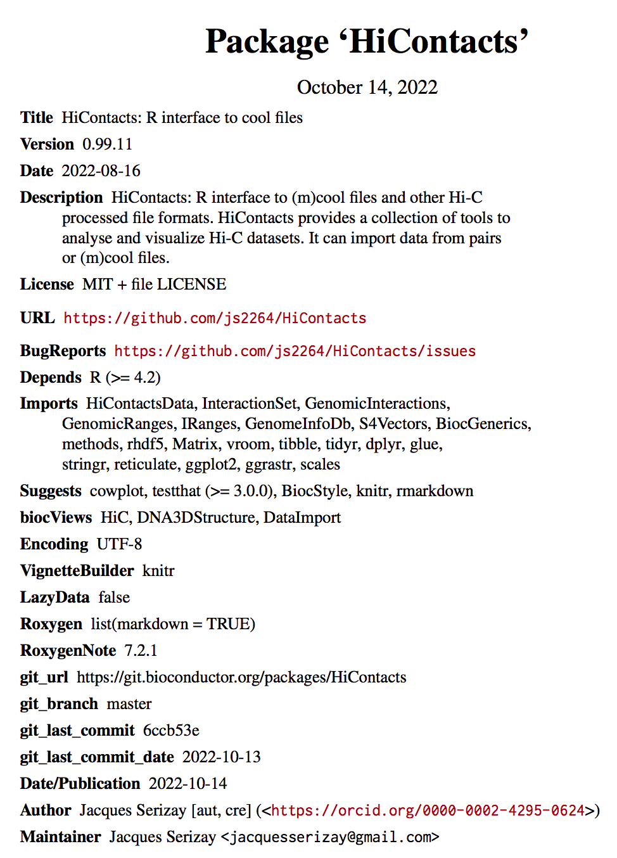
DESCRIPTION
myPackage/
data/
man/
inst/
tests/
vignettes/
R/
functions.R
utils.R
DESCRIPTION
NAMESPACE
README.md
NEWS
LICENSE

Slide 9
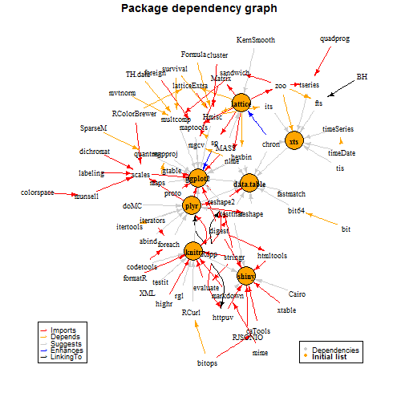
NAMESPACE
myPackage/
data/
man/
inst/
tests/
vignettes/
R/
functions.R
utils.R
DESCRIPTION
NAMESPACE
README.md
NEWS
LICENSE
# Generated by roxygen2: do not edit by hand
export(APA)
export(cool2gi)
export(cool2seqinfo)
export(detrend)
export(fetchCool)
export(formatCoords)
export(getAnchors)
export(getCounts)
export(getHicStats)
export(getPs)
export(ggMatrix)
export(ggPs)
export(ggtheme_HiContacts)
export(ggtheme_HiContacts_tracks)
export(gi2cm)
export(lsCoolFiles)
export(lsCoolResolutions)
export(pairs2gi)
export(peekCool)
export(plotMatrix)
export(splitCoords)
import(BiocParallel)
import(InteractionSet)
import(dplyr)
import(ggplot2)
import(ggrastr)
import(rhdf5)
import(scales)
import(stringr)
import(tibble)
import(tidyr)
import(tools)
import(zeallot)
importFrom(GenomeInfoDb,Seqinfo)
importFrom(GenomeInfoDb,seqlengths)
importFrom(GenomicRanges,GRanges)
importFrom(GenomicRanges,end)
importFrom(GenomicRanges,findOverlaps)
importFrom(GenomicRanges,mcols)
importFrom(GenomicRanges,resize)
importFrom(GenomicRanges,seqnames)
importFrom(GenomicRanges,start)

Slide 10
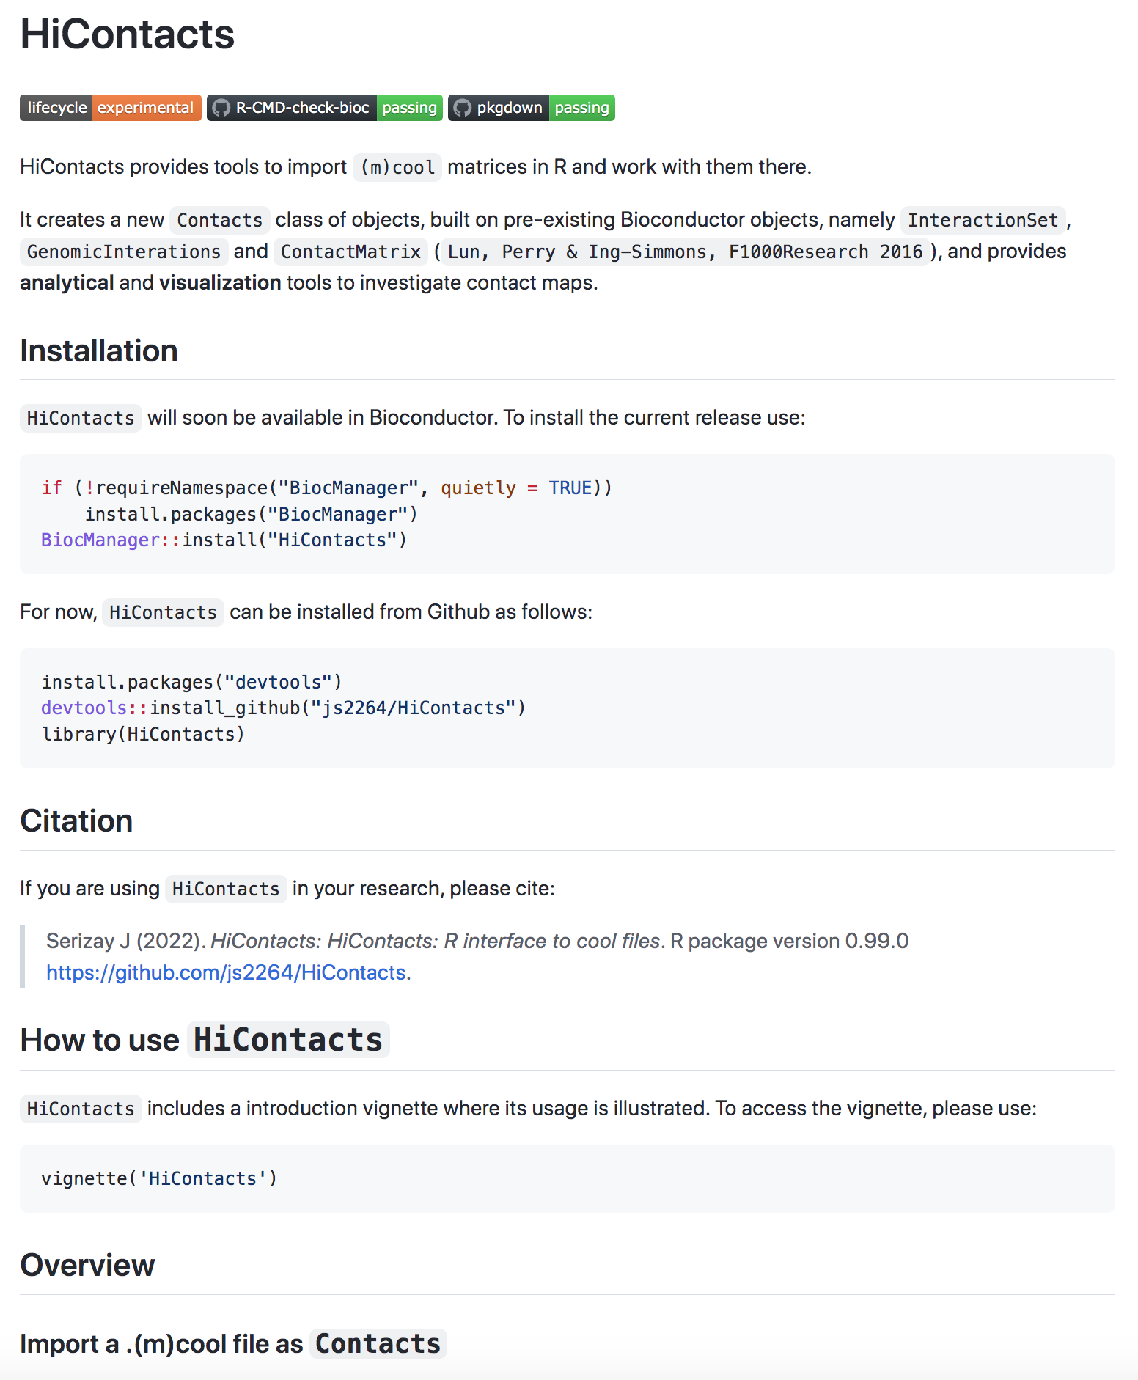
README.md
myPackage/
data/
man/
inst/
tests/
vignettes/
R/
functions.R
utils.R
DESCRIPTION
NAMESPACE
README.md
LICENSE
# HiContacts
HiContacts provides tools to import `(m)cool` matrices in R and work with them there.
It creates a new `Contacts` class of objects, built on pre-existing Bioconductor objects, namely `InteractionSet`, `GenomicInterations` and `ContactMatrix` (`Lun, Perry & Ing-Simmons, F1000Research 2016`), and provides **analytical** and **visualization** tools to investigate contact maps.
## Installation
`HiContacts` will soon be available in Bioconductor.
To install the current release use:
```r
if (!requireNamespace("BiocManager", quietly = TRUE))
install.packages("BiocManager")
BiocManager::install("HiContacts")
```
For now, `HiContacts` can be installed from Github as follows:
```r
install.packages("devtools")
devtools::install_github("js2264/HiContacts")
library(HiContacts)
```
## Citation
If you are using `HiContacts` in your research, please cite:
> Serizay J (2022). _HiContacts: HiContacts: R interface to cool files_.
> R package version 0.99.0
> <https://github.com/js2264/HiContacts>.
## How to use `HiContacts`
`HiContacts` includes a introduction vignette where its usage is
illustrated. To access the vignette, please use:
```r
vignette('HiContacts')
```
## Overview
### Import a .(m)cool file as `Contacts`
...

Slide 11
NEWS
myPackage/
data/
man/
inst/
tests/
vignettes/
R/
functions.R
utils.R
DESCRIPTION
NAMESPACE
README.md
NEWS
LICENSE
# periodicDNA 0.3.2 (dev)
* IMPORTANT:
- Implemented data-raw for reproducibility
* MINOR:
- Changed xlim of norm. distr. plot in plotPeriodicityResults()
# periodicDNA 0.3.1 (2020-05-05)
* IMPORTANT:
- rollmean(k=3) is now applied *before* normalisation *as well*,
on the raw distribution vector
- plotPeriodicityResults() output returns one single plot (with cowplot)
- getPeriodicityTrack() now returns the Rle
- Improved plotting functions -now show shuffled for plotPeriodicityResults()
- Added ggplot2 theming
* MINOR:
* Changed many variable names (all to snake_case)
* sampleGRanges is now full-fledged function
(GRanges, DNAStringSet, character and BSgenome methods)
* sampleGenome is an alias for sampleGRanges.character
* Added sacCer3 to getPeriodicity BSgenomes
* Added DNAString method for getPeriodicity
* Added a vignette describing the internal steps
* Clarified user-level functions in README
* Added ce11_TSSs data
* Renamed generateperiodicitytrack as getPeriodicityTrack
* Renamed variables in getFPI and getPeriodicity
* Created a utility char2BSgenome()
# periodicDNA 0.3.0 (2020-05-03)
* Added tests
* Added getFPI function
* cleaned-up functions
* cleaned-up function dependencies
* Added toy data
* Added vignette
# periodicDNA 0.2.1 (2020-03-04)
* Added Travis build check
* Simplified README.md

Slide 12
LICENSE
myPackage/
data/
man/
inst/
tests/
vignettes/
R/
functions.R
utils.R
DESCRIPTION
NAMESPACE
README.md
NEWS
LICENSE
GNU General Public License
==========================
_Version 3, 29 June 2007_
_Copyright © 2007 Free Software Foundation, Inc. &lt;<http://fsf.org/>&gt;_
Everyone is permitted to copy and distribute verbatim copies of this license
document, but changing it is not allowed.
## Preamble
The GNU General Public License is a free, copyleft license for software and other
kinds of works.
The licenses for most software and other practical works are designed to take away
your freedom to share and change the works. By contrast, the GNU General Public
License is intended to guarantee your freedom to share and change all versions of a
program--to make sure it remains free software for all its users. We, the Free
Software Foundation, use the GNU General Public License for most of our software; it
applies also to any other work released this way by its authors. You can apply it to
your programs, too.
When we speak of free software, we are referring to freedom, not price. Our General
Public Licenses are designed to make sure that you have the freedom to distribute
copies of free software (and charge for them if you wish), that you receive source
code or can get it if you want it, that you can change the software or use pieces of
it in new free programs, and that you know you can do these things.
To protect your rights, we need to prevent others from denying you these rights or
asking you to surrender the rights. Therefore, you have certain responsibilities if
you distribute copies of the software, or if you modify it: responsibilities to
respect the freedom of others.
For example, if you distribute copies of such a program, whether gratis or for a fee,
you must pass on to the recipients the same freedoms that you received. You must make
sure that they, too, receive or can get the source code. And you must show them these
terms so they know their rights.
Developers that use the GNU GPL protect your rights with two steps: **(1)** assert
copyright on the software, and **(2)** offer you this License giving you legal permission
to copy, distribute and/or modify it.
For the developers' and authors' protection, the GPL clearly explains that there is
no warranty for this free software. For both users' and authors' sake, the GPL
requires that modified versions be marked as changed, so that their problems will not
be attributed erroneously to authors of previous versions.
Some devices are designed to deny users access to install or run modified versions of
the software inside them, although the manufacturer can do so. This is fundamentally
incompatible with the aim of protecting users' freedom to change the software. The
systematic pattern of such abuse occurs in the area of products for individuals to
use, which is precisely where it is most unacceptable. Therefore, we have designed
this version of the GPL to prohibit the practice for those products. If such problems
arise substantially in other domains, we stand ready to extend this provision to
those domains in future versions of the GPL, as needed to protect the freedom of
users.
Finally, every program is threatened constantly by software patents. States should
not allow patents to restrict development and use of software on general-purpose
computers, but in those that do, we wish to avoid the special danger that patents
applied to a free program could make it effectively proprietary. To prevent this, the
GPL assures that patents cannot be used to render the program non-free.
The precise terms and conditions for copying, distribution and modification follow.
## TERMS AND CONDITIONS
### 0. Definitions
“This License” refers to version 3 of the GNU General Public License.
“Copyright” also means copyright-like laws that apply to other kinds of
works, such as semiconductor masks.

Slide 13
Function files
myPackage/
data/
man/
inst/
tests/
vignettes/
R/
functions.R
utils.R
DESCRIPTION
NAMESPACE
README.md
NEWS
LICENSE
#' Parsing (m)cool files
#'
#' These functions are the workhorse internal functions used to import
#' a `.(m)cool` file as GenomicInteractions (wrapped into a `Contacts` object
#' by `Contacts()` function).
#'
#' @param file file
#' @param resolution resolution
#' @param balanced import balancing scores
#' @return anchors from (m)cool, stored as a GRanges
#'
#' @importFrom GenomicRanges GRanges
#' @importFrom GenomicRanges seqnames
#' @importFrom GenomicRanges start
#' @importFrom GenomicRanges end
#' @importFrom IRanges IRanges
#' @rdname parse
getAnchors <- function(file, resolution = NULL, balanced = "cooler") {
bins <- fetchCool(file, "bins", resolution)
anchors <- GenomicRanges::GRanges(
bins$chr,
IRanges::IRanges(bins$start + 1, bins$end),
bin_id = seq_along(bins$chr),
seqinfo = cool2seqinfo(file, resolution)
)
names(anchors) <- paste(GenomicRanges::seqnames(anchors), GenomicRanges::start(anchors), GenomicRanges::end(anchors), sep = "_")
if ("weight" %in% names(bins) & {
balanced == "cooler" | balanced == TRUE
}) {
anchors$weight <- as.numeric(bins$weight)
} else {
weight <- 1
}
return(anchors)
}

Slide 14
Doc files
myPackage/
data/
man/
functions.Rd
inst/
tests/
vignettes/
R/
functions.R
utils.R
DESCRIPTION
NAMESPACE
README.md
NEWS
LICENSE
% Generated by roxygen2: do not edit by hand
% Please edit documentation in R/parse.R
\name{getAnchors}
\alias{getAnchors}
\alias{getCountsFromPair}
\alias{getCounts}
\alias{fetchCool}
\alias{lsCoolFiles}
\alias{lsCoolResolutions}
\alias{peekCool}
\alias{cool2seqinfo}
\alias{cool2gi}
\alias{gi2cm}
\alias{cm2matrix}
\alias{pairs2gi}
\title{Parsing (m)cool files}
\usage{
getAnchors(file, resolution = NULL, balanced = "cooler")
\arguments{
\item{file}{pairs file: \verb{<readname>\\t<chr1>\\t<start1>\\t<chr2>\\t<start2>}}
\item{resolution}{resolution}
\item{balanced}{import balancing scores}
}
\value{
anchors from (m)cool, stored as a GRanges
}
\description{
These functions are the workhorse internal functions used to import
a \verb{.(m)cool} file as GenomicInteractions (wrapped into a \code{Contacts} object
by \code{Contacts()} function).
}

Slide 15
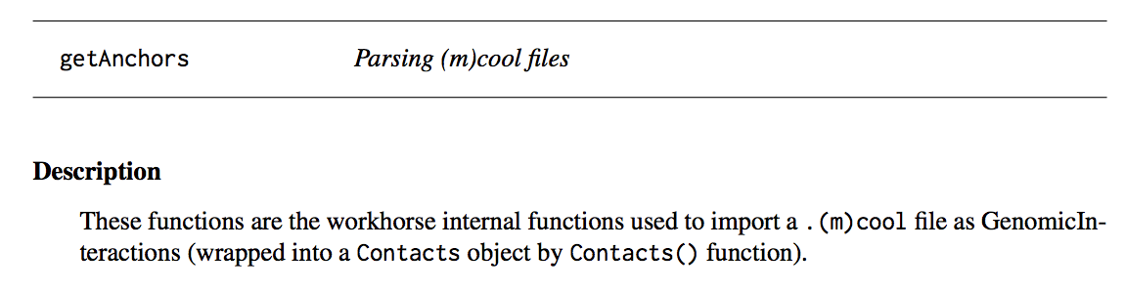
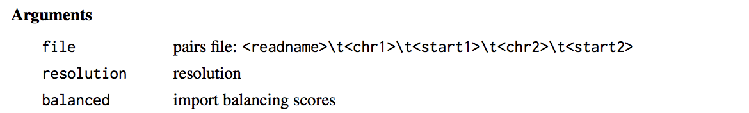
Doc files
pdf documentation once package is published
myPackage/
data/
man/
functions.Rd
inst/
tests/
vignettes/
R/
functions.R
utils.R
DESCRIPTION
NAMESPACE
README.md
NEWS
LICENSE

Slide 16
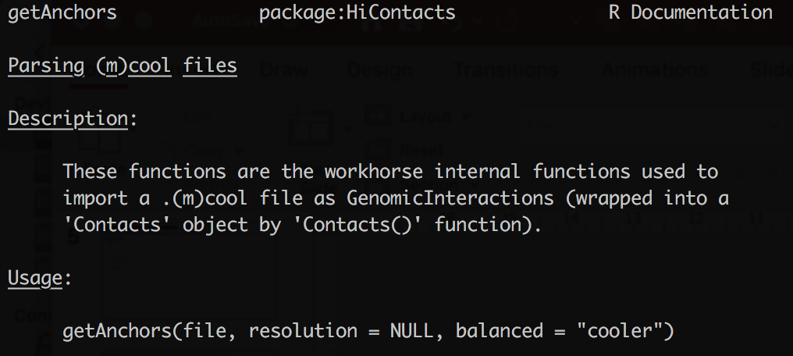
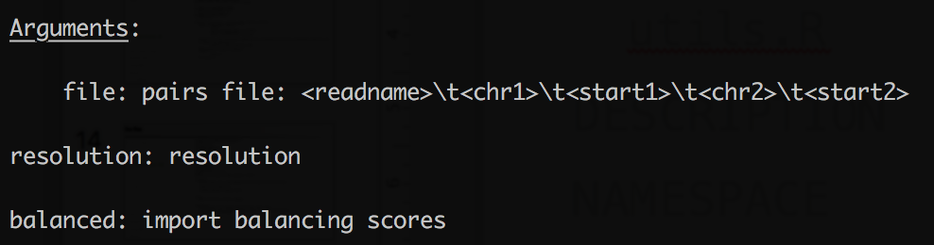
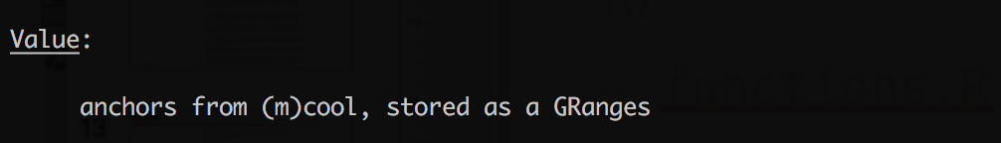
Doc files
?getAnchors
myPackage/
data/
man/
functions.Rd
inst/
tests/
vignettes/
R/
functions.R
utils.R
DESCRIPTION
NAMESPACE
README.md
NEWS
LICENSE

Slide 17
Source/Bundle/Binary/Installed/Loaded: késako?
myPackage/
data/
man/
inst/
tests/
vignettes/
R/
functions.R
utils.R
DESCRIPTION
NAMESPACE
README.md
NEWS
LICENSE

Slide 18
Source/Bundle/ Binary /Installed/Loaded: késako?
myPackage/
data/
man/
inst/
tests/
vignettes/
R/
functions.R
utils.R
DESCRIPTION
NAMESPACE
README.md
NEWS
LICENSE
Source

Slide 19
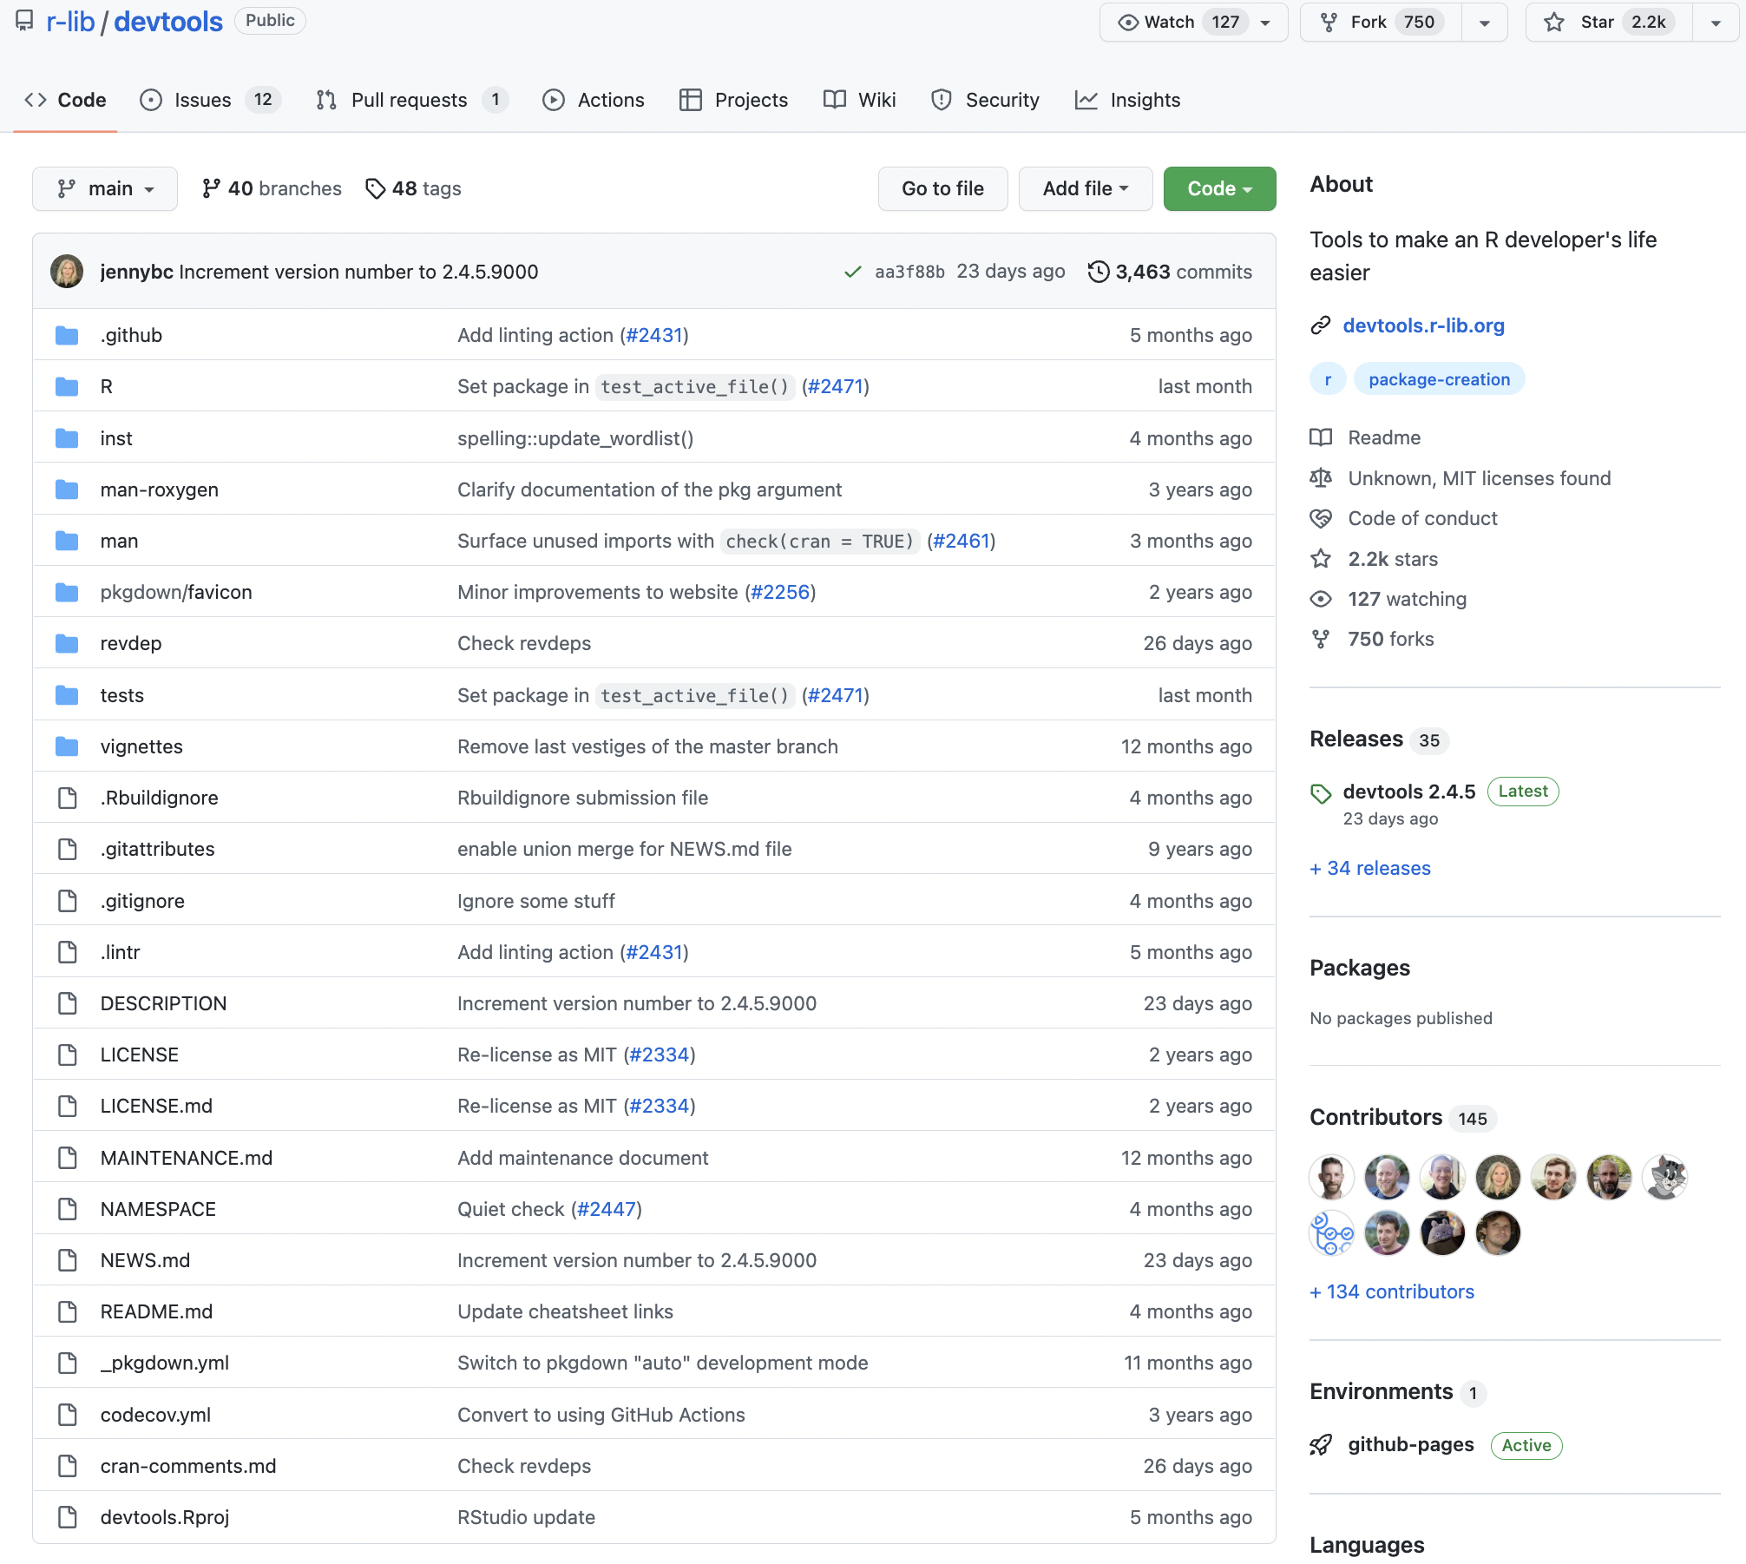
Source/Bundle/ Binary /Installed/Loaded: késako?
myPackage/
data/
man/
inst/
tests/
vignettes/
R/
functions.R
utils.R
DESCRIPTION
NAMESPACE
README.md
NEWS
LICENSE

Slide 20
Source/Bundle/ Binary /Installed/Loaded: késako?
myPackage/
data/
man/
inst/
tests/
vignettes/
R/
functions.R
utils.R
DESCRIPTION
NAMESPACE
README.md
NEWS
LICENSE
Bundle
myPackage.tar.gz

Slide 21
Source/Bundle/ Binary /Installed/Loaded: késako?
myPackage/
data/
man/
inst/
tests/
vignettes/
R/
functions.R
utils.R
DESCRIPTION
NAMESPACE
README.md
NEWS
LICENSE
Bundle
myPackage.tar.gz

Slide 22
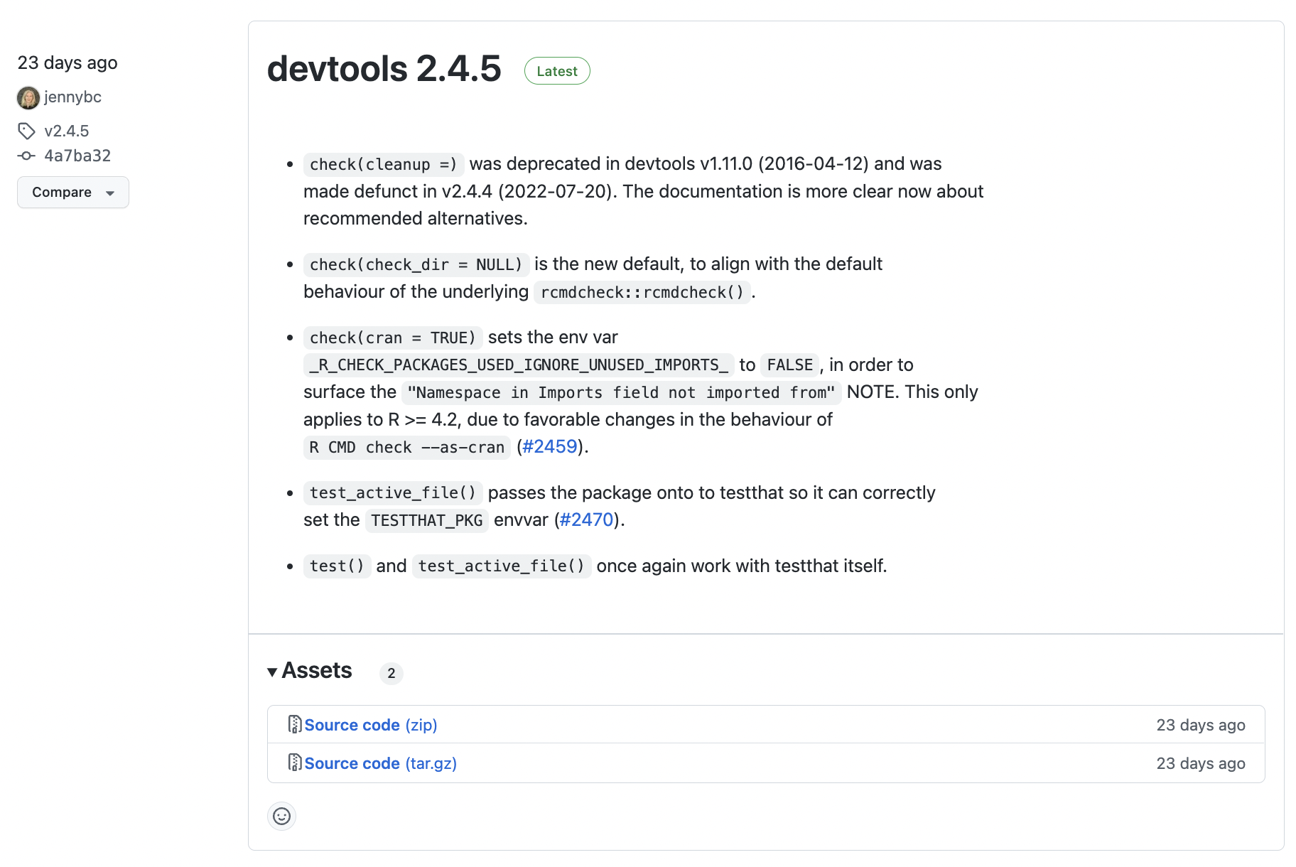
Source/Bundle/ Binary /Installed/Loaded: késako?
myPackage/
data/
man/
inst/
tests/
vignettes/
R/
functions.R
utils.R
DESCRIPTION
NAMESPACE
README.md
NEWS
LICENSE
Bundle
myPackage.tar.gz

Slide 23
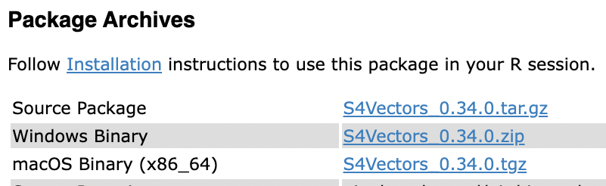
Source/Bundle/ Binary /Installed/Loaded: késako?
myPackage/
data/
man/
inst/
tests/
vignettes/
R/
functions.R
utils.R
DESCRIPTION
NAMESPACE
README.md
NEWS
LICENSE
Binary
myPackage.tar.gz
CRAN,
Bioconductor

Slide 24
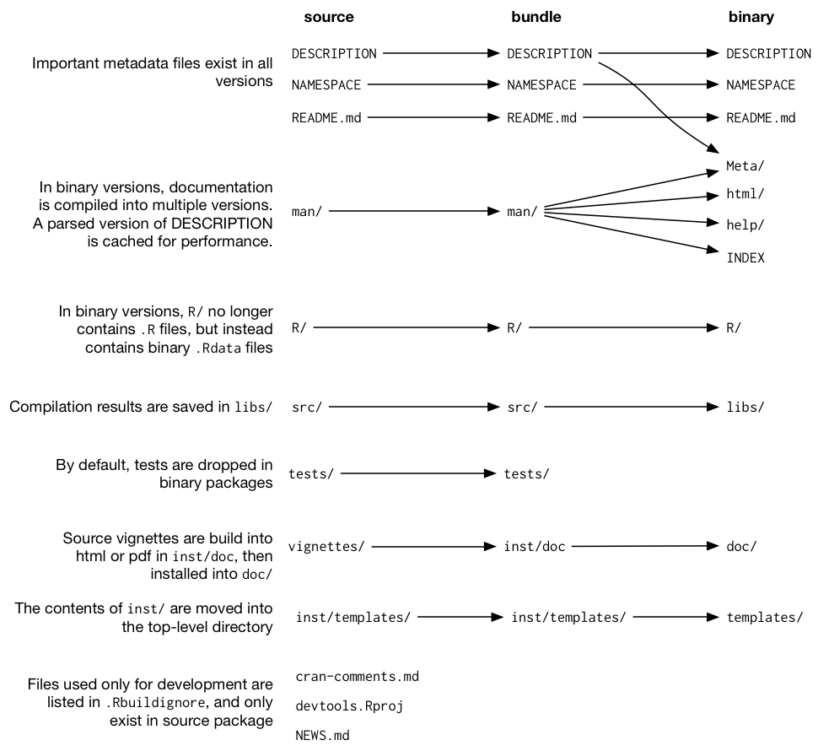
Source/Bundle/ Binary /Installed/Loaded: késako?

Slide 25
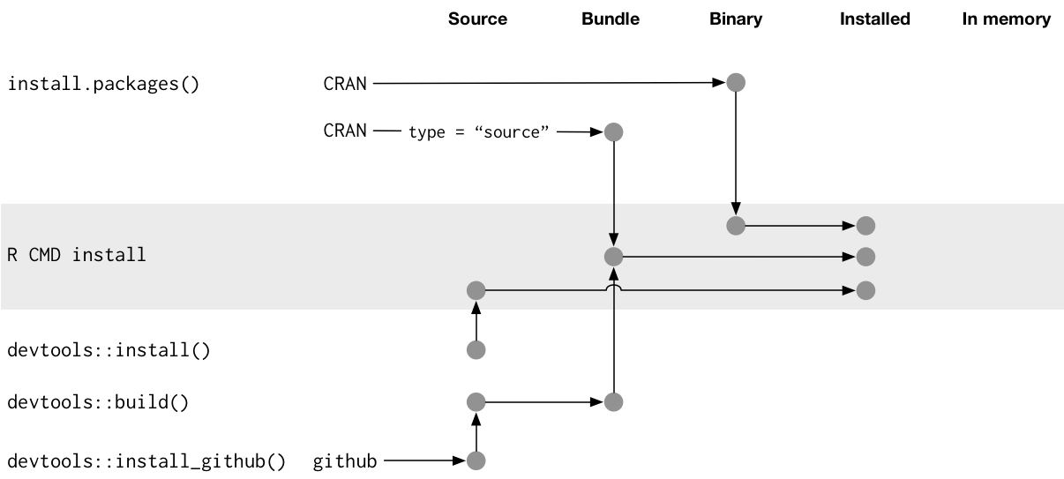
Source/Bundle/ Binary /Installed/Loaded: késako?

Slide 26
Read more…
https://r-pkgs.org/Structure.html

